Slide 1
SEIS 610 Course Project: Evolutionary Computing System July 2016
Developed and Presented by Maverick Edberg, Anders Skaar, Muntaser Khan, Brett Branan, & Aghogho Ometan
Notes:
introductions

Slide 2

Outline
Evolutionary Computing
Project Objectives and Requirements
System Development and Design Overview
Software Testing and Metrics
Software Project Demonstration
Results, conclusions, and future work
Notes:
Anders

Slide 3

Evolutionary Computing Project Overview
An evolutionary computing system is a form of artificial intelligence that uses Darwinian principles as a form or trial and error problem solving and/or optimization.
The evolutionary computing system defined in the SEIS 610 project deliverable finds the solution for a given training set of x and y inputs and outputs. An initial set of requirements has been given to the project teams through class content and lectures while the remaining requirements and any adjustments must be worked out as a project team.
Notes:
Anders (skip)

Slide 4
EC Project Objectives & Requirements
Software Requirements:
15 min maximum to generate a solution with the configured fitness value
Project may be easily adjusted to work with different functions in the event that the requirements have been changed (within less than 2 weeks)
Group Goals:
Find a solution with a fitness value of zero (perfect fit) in shortest amount of time
Employ a Graphical User Interface that allows user to adjust input parameters/settings
Use cross-platform programming languages to allow use on either OSX or Windows
Avoid bugs, system crashes, and any other errors from occurring by testing all code execution paths (CC)
Simplify code structure so it is maintainable, reliable, and efficient
Notes:
Anders

Slide 5
Requirements
Requirement Type | Requirement
Configuration | Must be able to take fitness set as input
Configuration | Fitness key value pairs are delimited by new lines, while key and value are delimited by a semicolon (e.g.: 12;456)
Configuration | Must detect and error on malformed fitness set input
Configuration | Must detect and error on empty fitness set input
Configuration | Must be able to take population size as input
Configuration | Population size input has a min of 7 and max or 20
Configuration | Must be able to take max tree height as input
Configuration | Max tree height input has a min of 3 and a max of 5
Configuration | Must be able to take target fitness value as input
Configuration | Target fitness value input has a min of 0 and a max of 100
Configuration | Must be able to take maximum run time as input in minutes
Configuration | Maximum run time input has a min of 1 minute and a max of 15 minutes
Notes:
Maverick

Slide 6
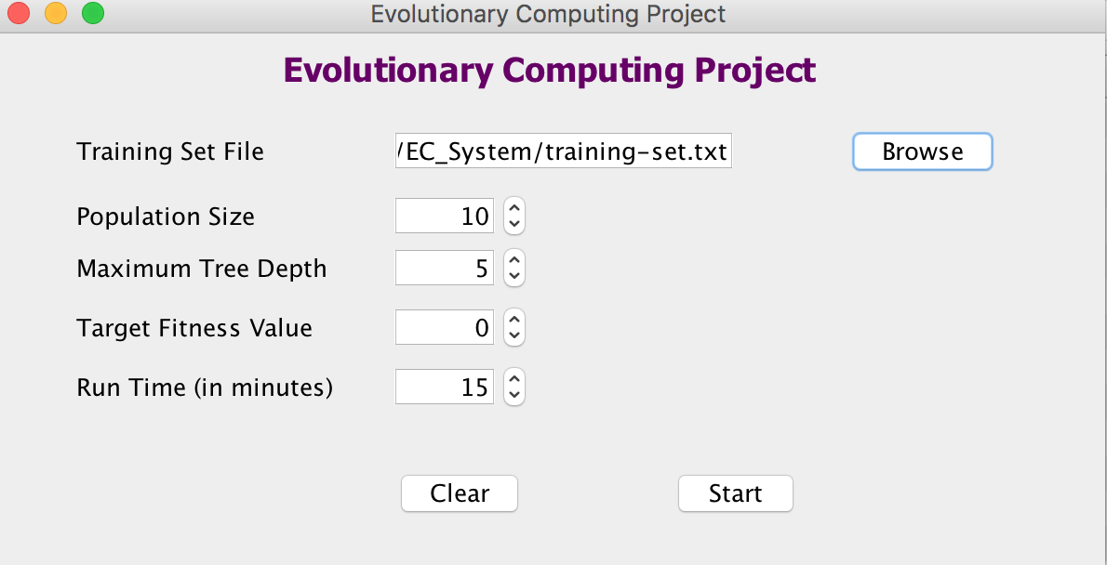
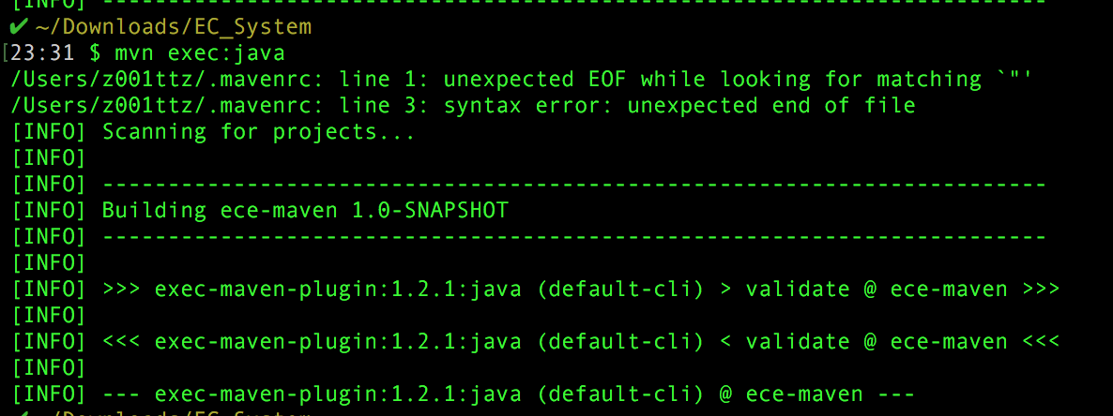
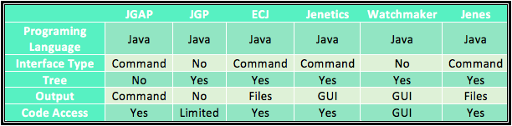
Software Design
Incremental development approach
Prototype was built early in development process, with core functionality as foundation to build upon
Performance improvements and new features (ex: GUI) were added over time incrementally
Employed custom Java solution for programming (see table below)
Java allows for cross-platform use
Most familiar programming language among team members → allowing for faster progress and ability to enhance functionality (such as a GUI)
Original prototype (CMD line interface)
Final GUI Interface
Notes:
Maverick

Slide 7
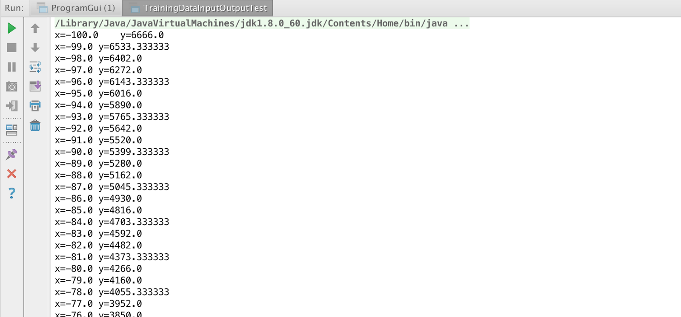
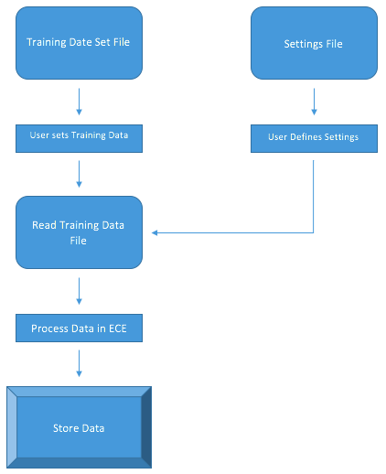
Software Design: Data Flow Diagram
By putting the training data into a .txt file separate from the program itself, the user has much greater flexibility. A GUI that appears when the software opens allows the user to select any .txt file (training data) that they desire.If the target function needs to be changed, then a new .txt file can simply be generated for that function using an alternative set values corresponding to the function of choice.
Notes:
Joy

Slide 8
RUN PROJECT DEMONSTRATION
Notes:
Muntaser

Slide 9
Software Testing and Metrics
Unit Testing
Programmatically test as many code paths of our application as possible as determined by our code’s Cyclomatic Complexity.
Code coverage of > 95%.
Data Input/Output Testing
Programmatically test the I/O components of our application.
Reads in the supplied training set.
Outputs the supplied training set to the console.
Notes:
Muntaser

Slide 10
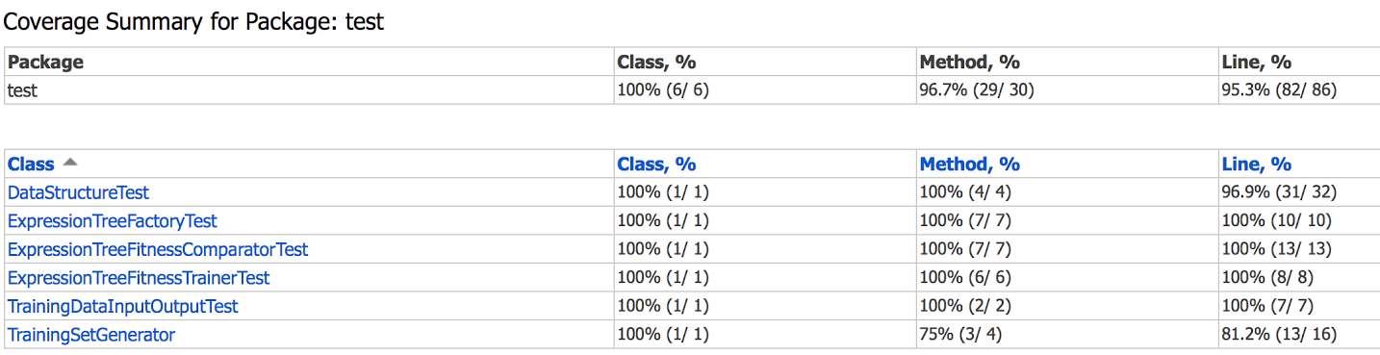
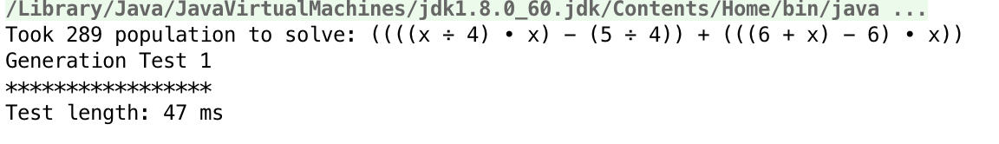
Software Testing and Metrics
Data Structure Testing
Programmatically test the underlying data structure of our application.
Create a random population of expression trees.
Evolve the population if the target fitness value has not been met.
Output the solution, the run time, and the population count otherwise.
QA Testing
Manually test our application for requirements adherence and user acceptance.
Running our application on both Windows and OSX devices.
Notes:
Muntaser

Slide 11
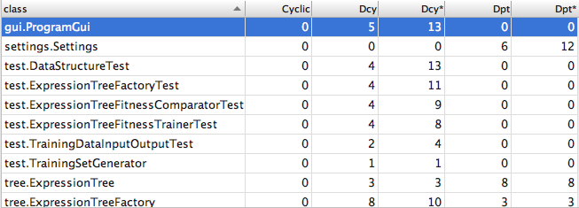
Software Testing and Metrics
Metrics
Complexity Metrics
Average Operation Complexity (Cyclomatic Complexity)
Weighted Method Complexity (∑ Method Complexities)
Dependency Metrics
Dependencies
Both direct and transitive dependency counts
Dependents
Both direct and transitive dependent counts
Lines of Code Metrics
Java Lines of Code
Product Lines of Code
Testing Lines of Code
Notes:
Maverick

Slide 12
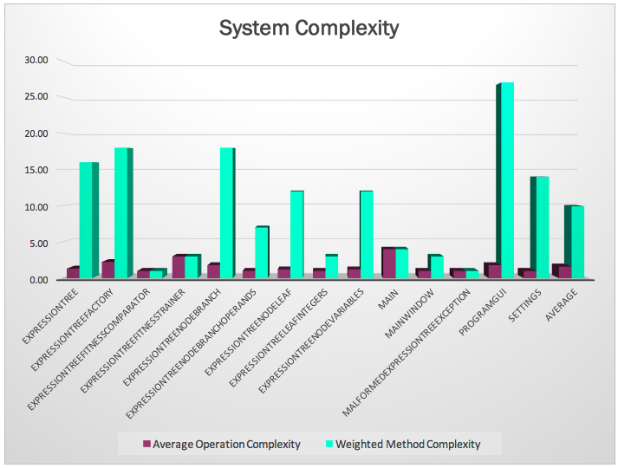
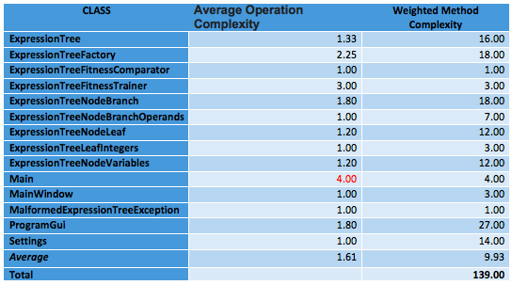
Complexity Metrics
Notes:
Maverick

Slide 13
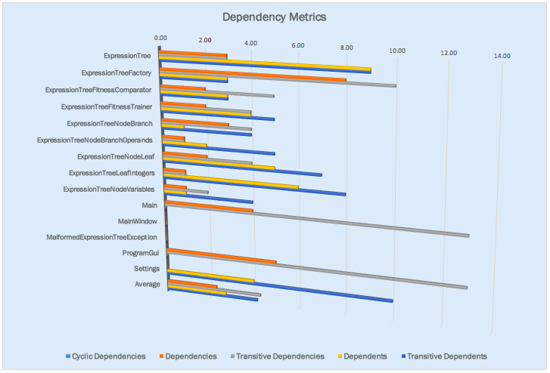
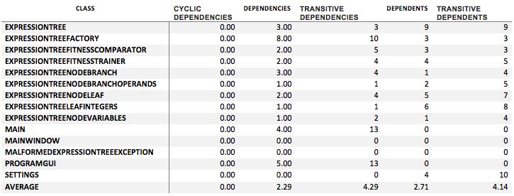
Dependency Metrics
Notes:
Maverick

Slide 14
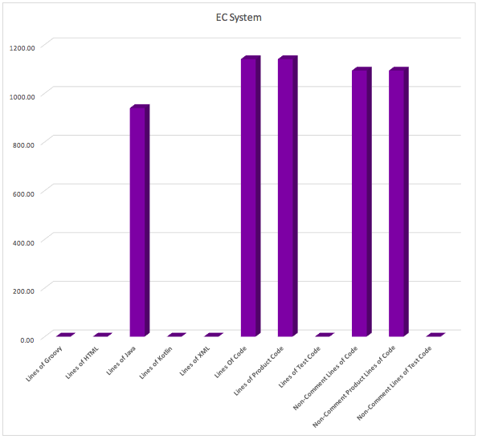
Lines of Code Metrics
Notes:
Maverick

Slide 15
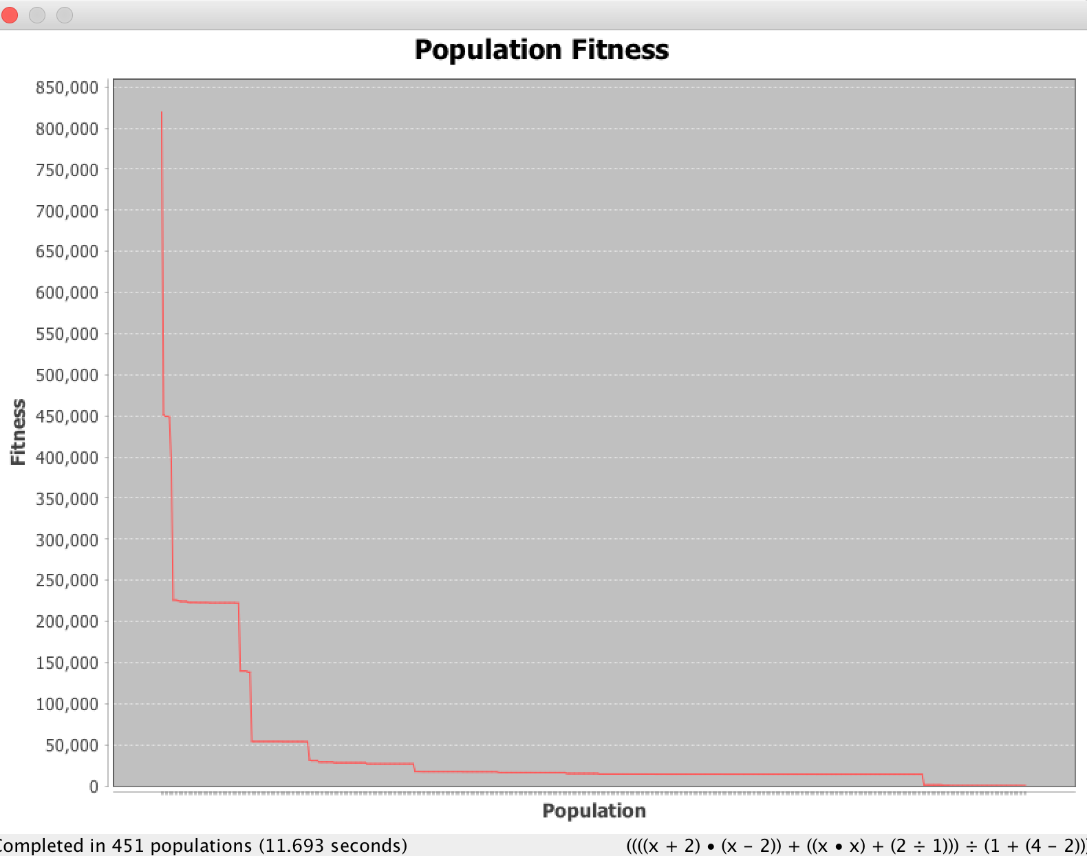

Results
Solves in under 15m
Adheres to all requirements and group defined goals
> 95% testing code coverage
Satisfactory code metrics
No outstanding issues or bug fixes
11.693 s
Notes:
Joy

Slide 16
Conclusion
Results Summary
We consider our project a success (see results section above).
Areas for improvement include issue tracking (collaboration) and work delegation.
Lessons Learned / Areas for Improvement
The GitLab issue tracking tool should have been used to track more non-development related tasks.
Better accountability
Better insight into project status
Our project team should have better defined “management” roles.
More accountable and transparent chain of delegation
Future Work / Potential Improvements
Feature request that allows the automatic generation of a training set, allowing the user to specify its range and step size.
For further testing purposes and program simplification.
Feature request that includes porting the application to mobile.
Java would allow easier port to Android.
Feature enhancement to include more output options.
Generate graphs, tables, or other visuals based on preference.
Notes:
Brett

Slide 17
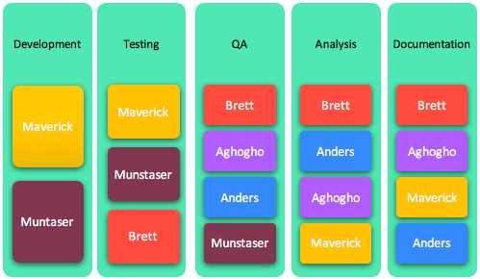
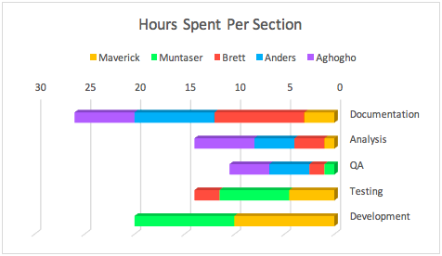
SCM Documentation
Notes:
Joy

Slide 18




Appliances Used
Gitlab (Source Control)
MetricReloaded (Cyclomatic Complexity)
Eclipse (IDE)
IntellJ (IDE)
EclEmma (Unit Test Code Coverage)
JUnit 4 (Unit Test)
Microsoft Word/Excel/PowerPoint
Google Drive/Google Docs
Notes:
Brett

Slide 19
References
https://www.quora.com/In-Java-when-should-you-use-an-interface-instead-of-an-abstract-class
http://programmers.stackexchange.com/questions/253254/why-should-i-use-a-factory-class-instead-of-direct-object-construction
Software Engineering: A Practitioner's Approach, by Roger Pressman, Bruce Maxim,McGraw-Hill, 2014.
Chih Lai, Ph.D. SIES 610 Software Engineering, Lecture Slides. St. Thomas University. Summer 2016.
Eclipse.com, Eclipse Logo. https://eclipse.org/eclipse.org-common/themes/solstice/public/images/logo/eclipse-800x188.png, July 2016.
Google.com, Google Logo. http://dwglogo.com/wp-content/uploads/2016/06/Google-2015-logo.png, July 2016.
Gitlab.com, Gitlab Logo. https://gitlab.com/uploads/project/avatar/13083/gitlab-logo-square.png, July 2016.
Osx.vn, IntelliJ Logo. http://osx.vn/attachments/ij-png.4895, July 2016.

Slide 20
Backup Slides

Slide 21
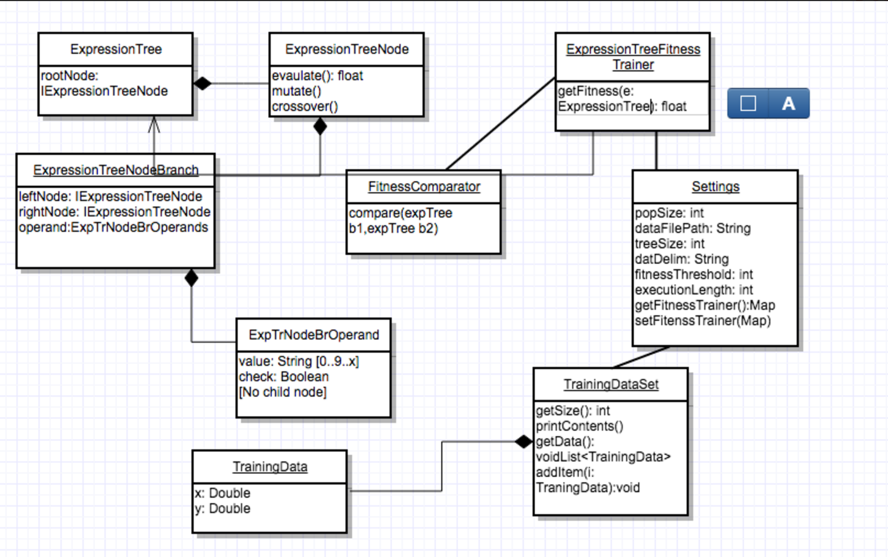
OO Model

Slide 22
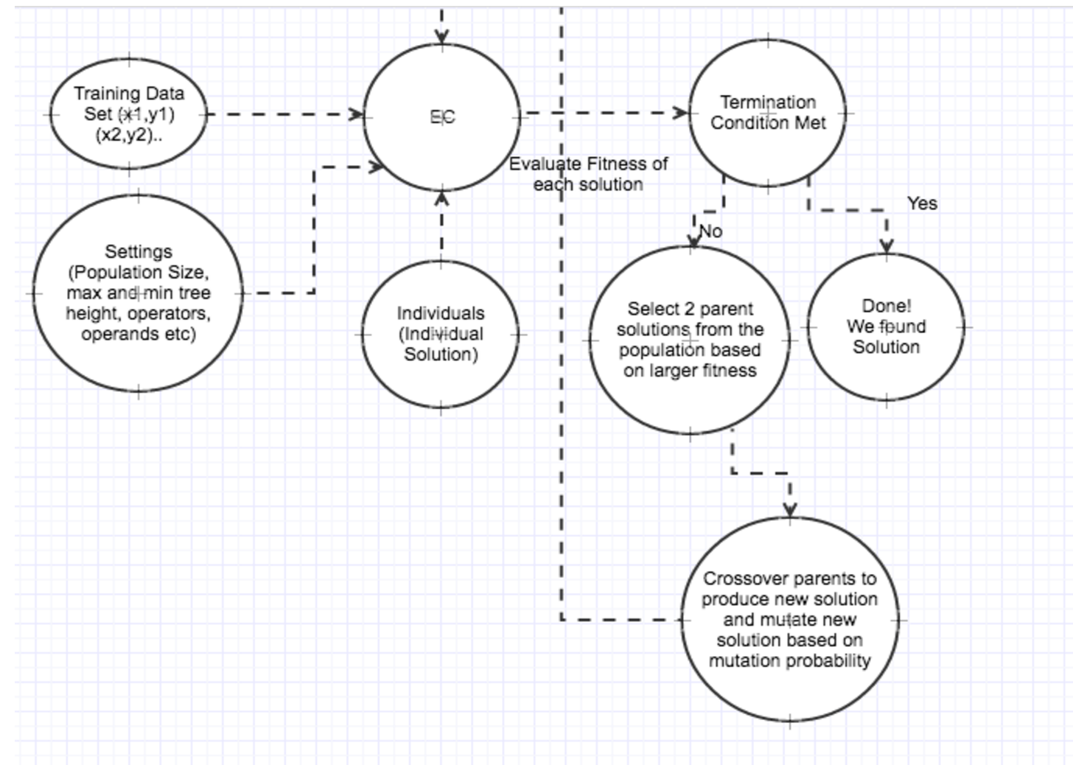
FSM

